Slide 1
Web Application
By: Andrew, Blake, Isaac, Ryan

Slide 2
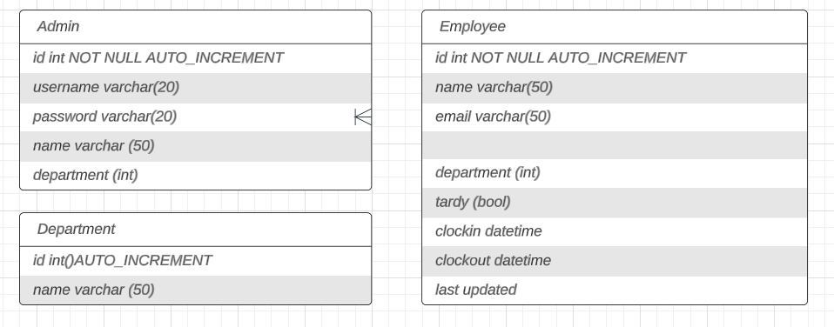
DataBases

Slide 3
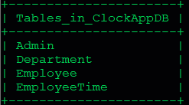
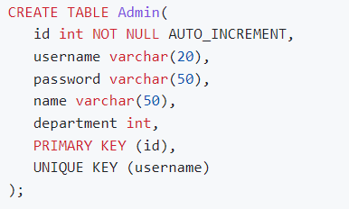

DataBases

Slide 4


DataBases

Slide 5

Databases

Slide 6

Front End
Link to Employee Login, Hosted with Github pages - Here
Link to Admin Login, Also Hosted with Github pages - Here

Slide 7
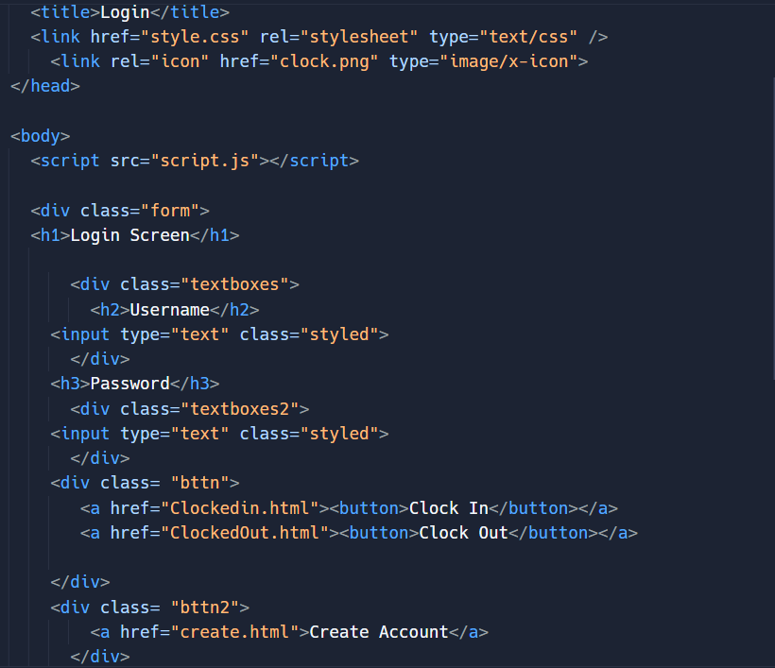
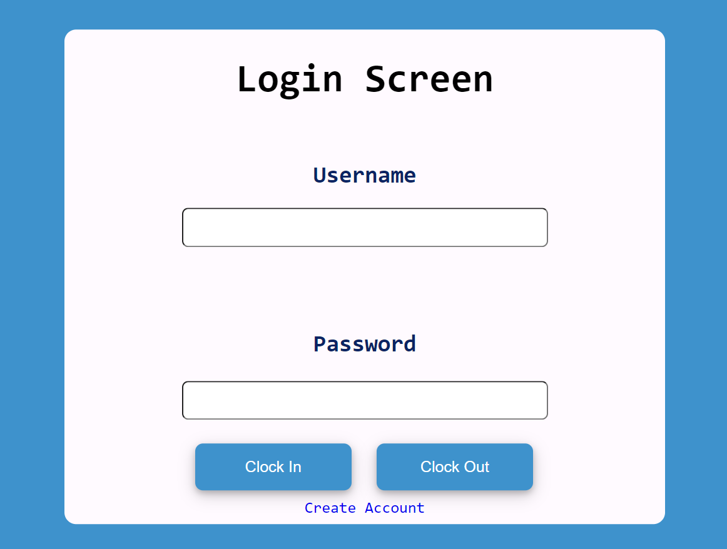
Front End- Employee Login Screen

Slide 8
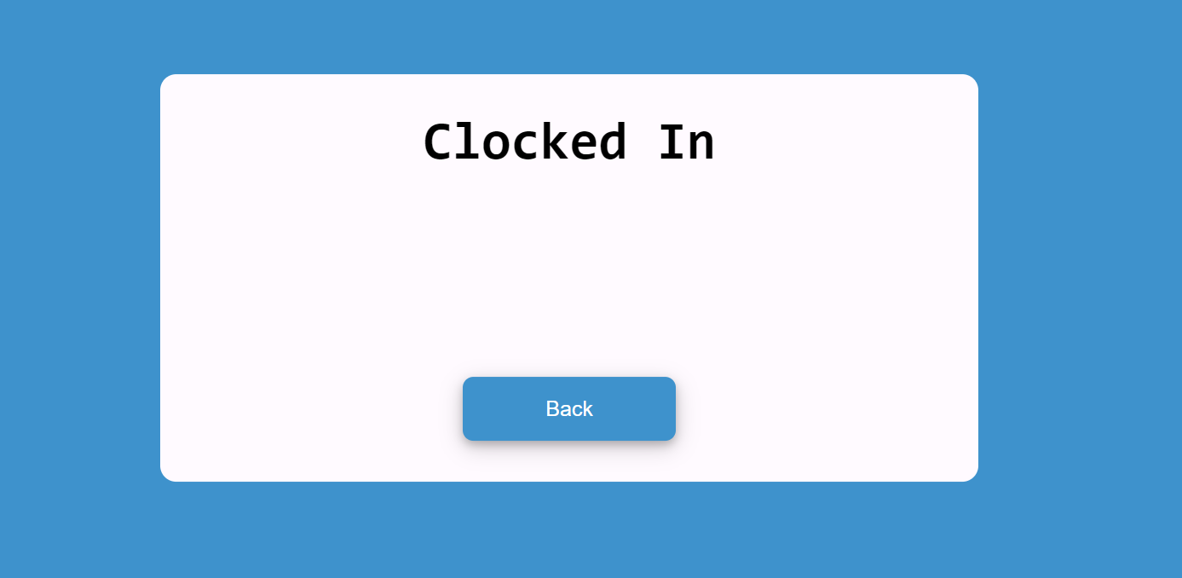
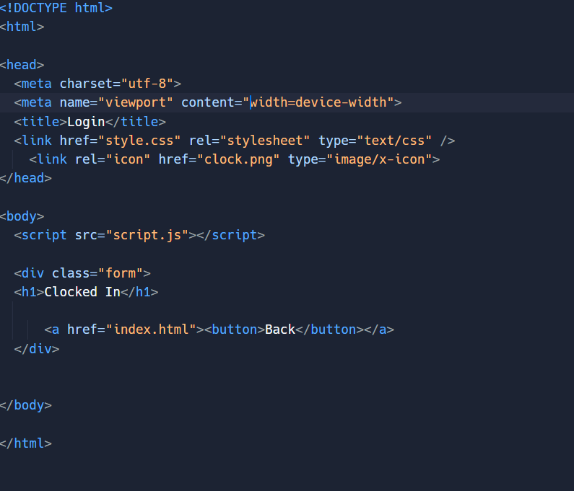
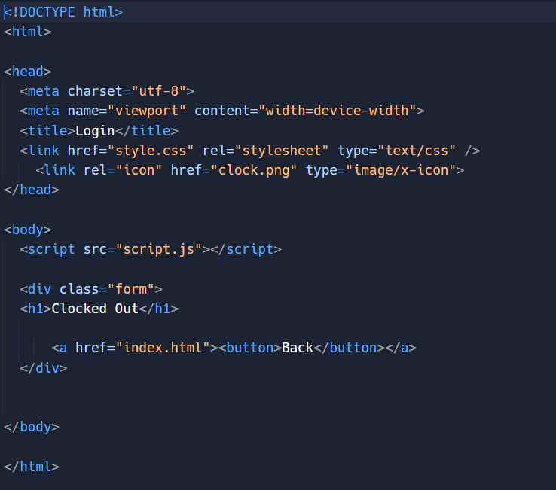
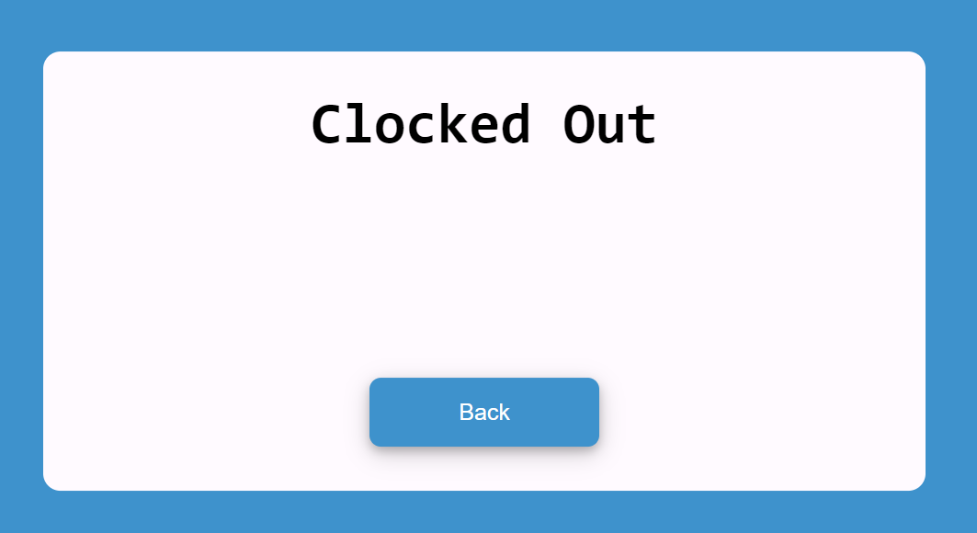
Front End- Employee Clocked In/Clocked Out
Clocked In Clocked Out

Slide 9
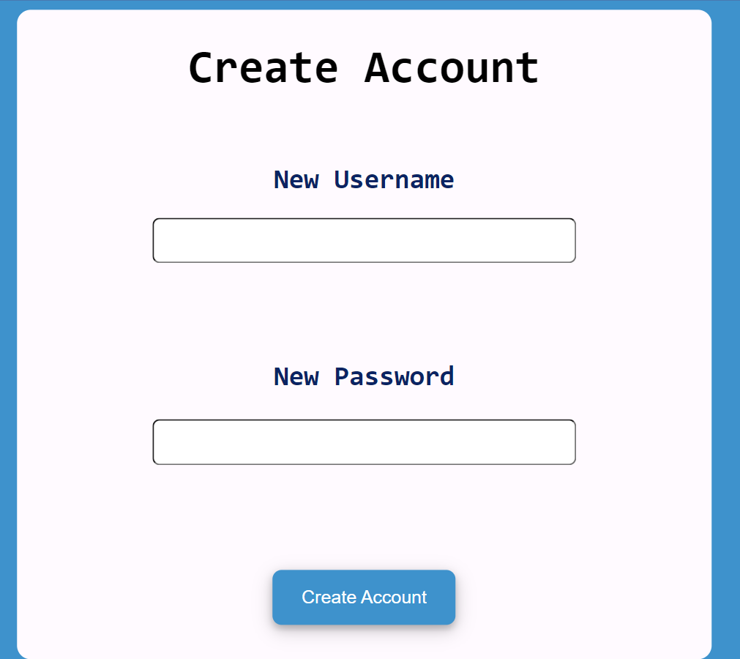
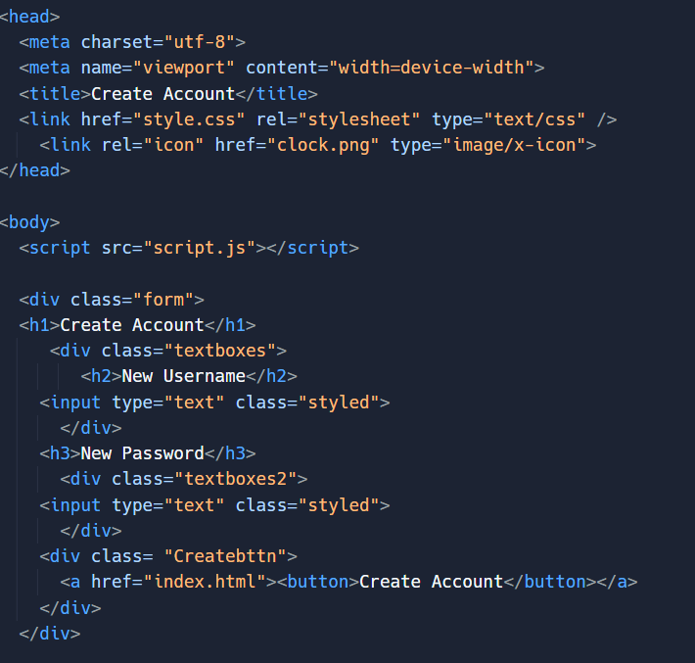
Front End- Employee Create Account

Slide 10
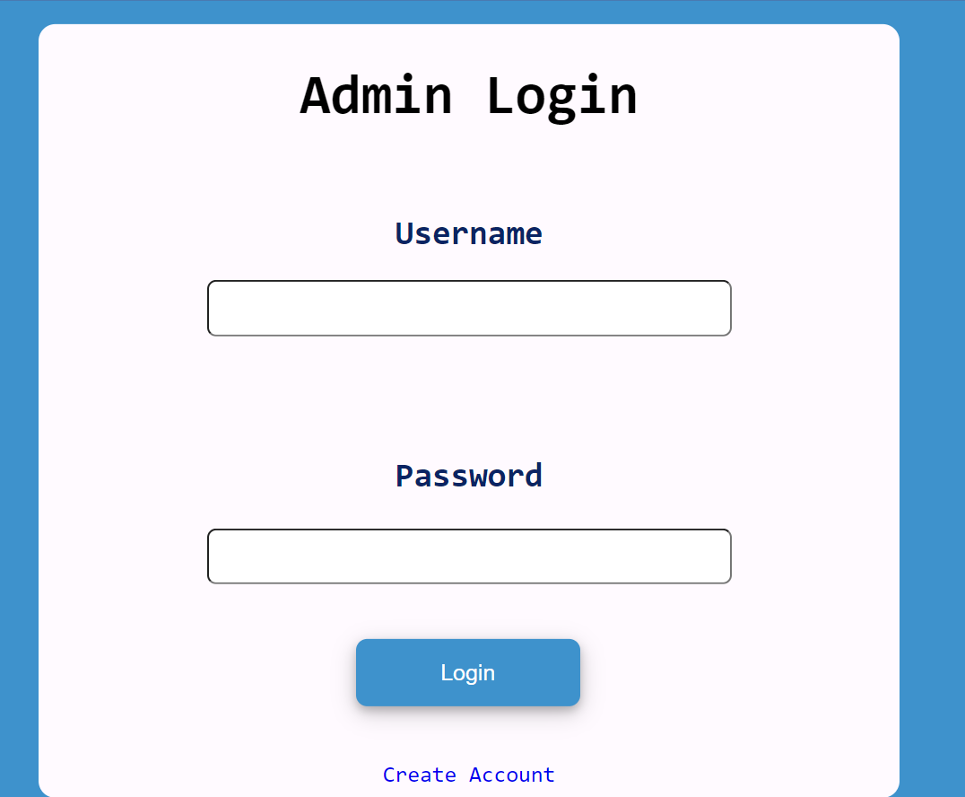
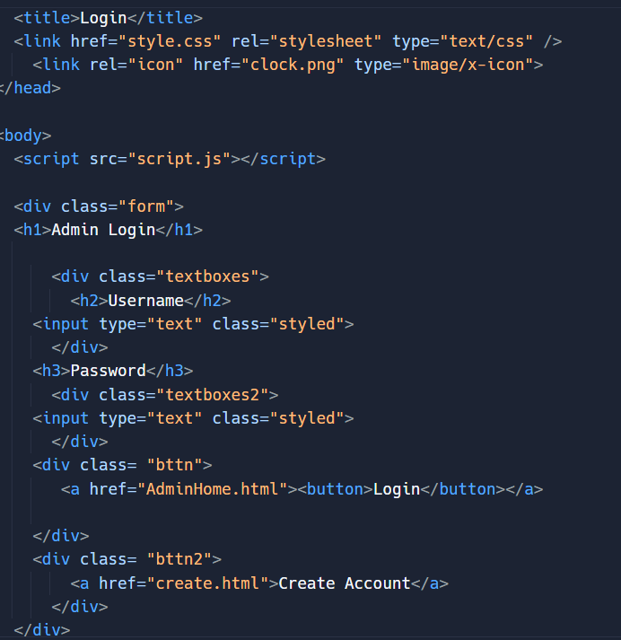
Front End- Admin Login Screen

Slide 11
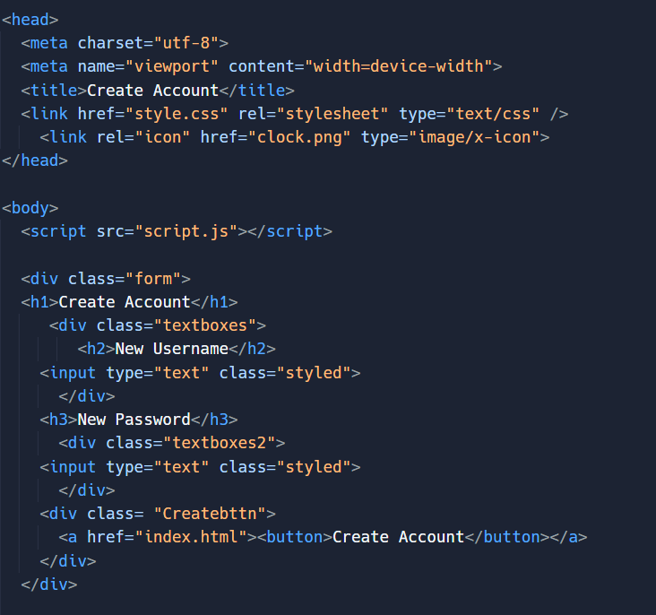
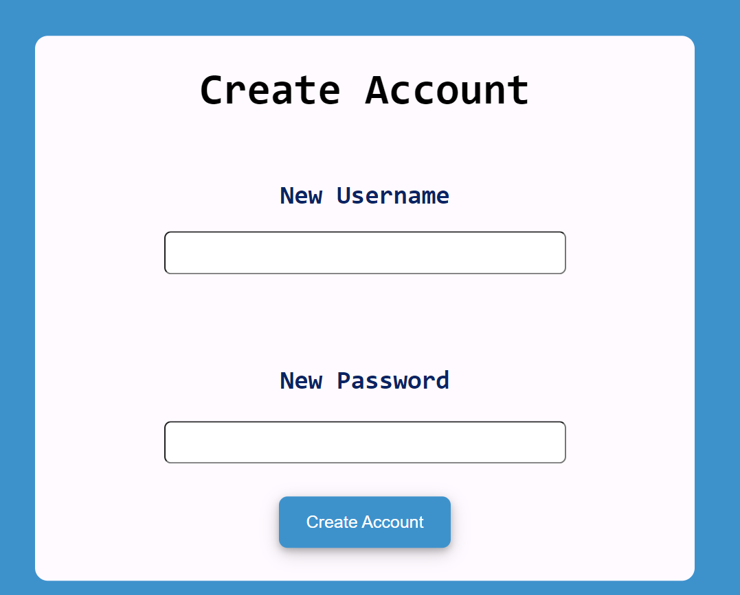
Front End- Admin Create Account
Same HTML and CSS from Employee Login

Slide 12
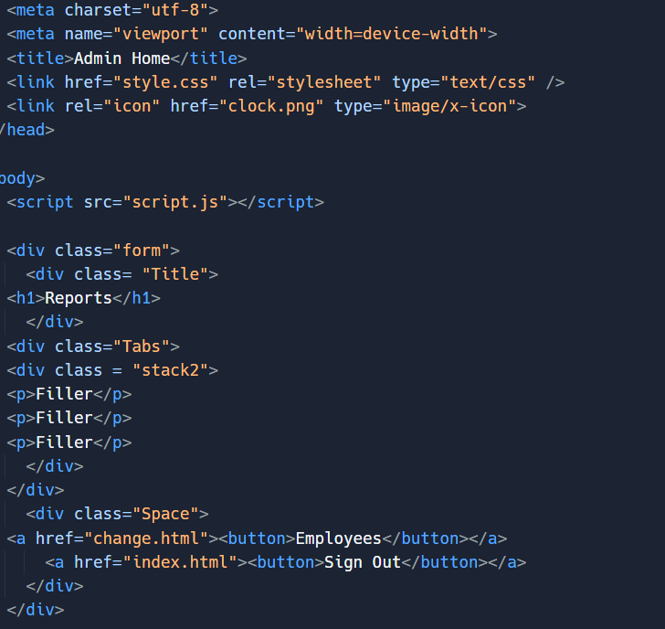
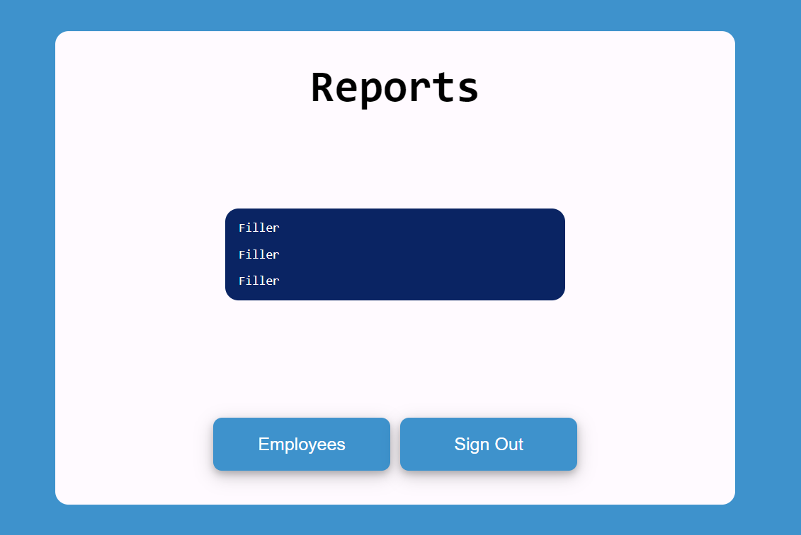
Front End- Admin Reports Page

Slide 13
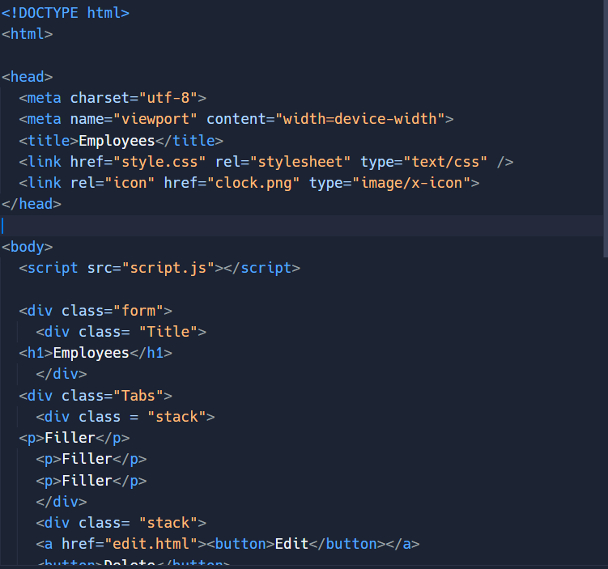
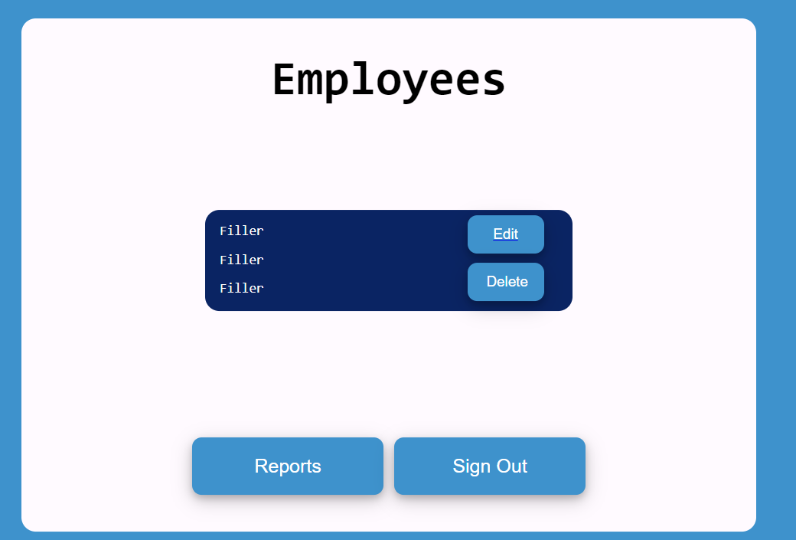
Front End- Admin Viewer Page

Slide 14
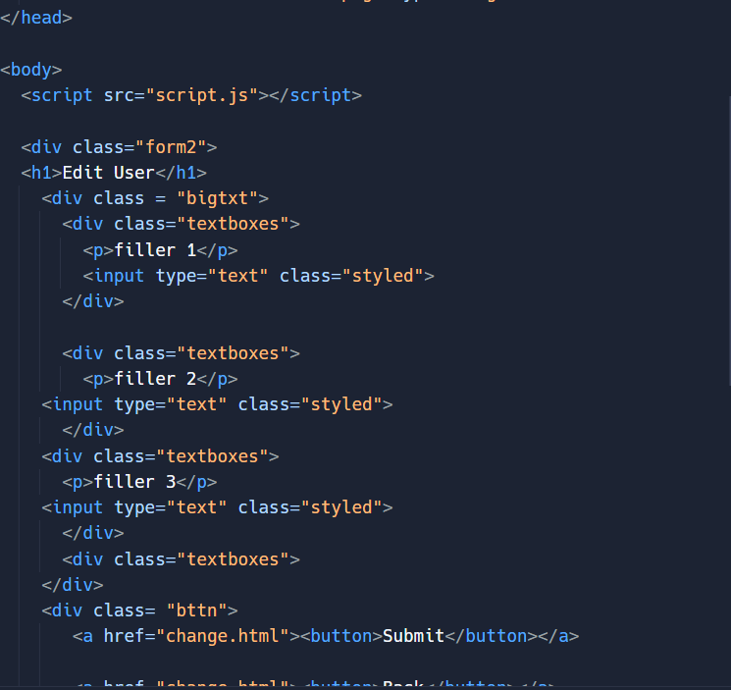
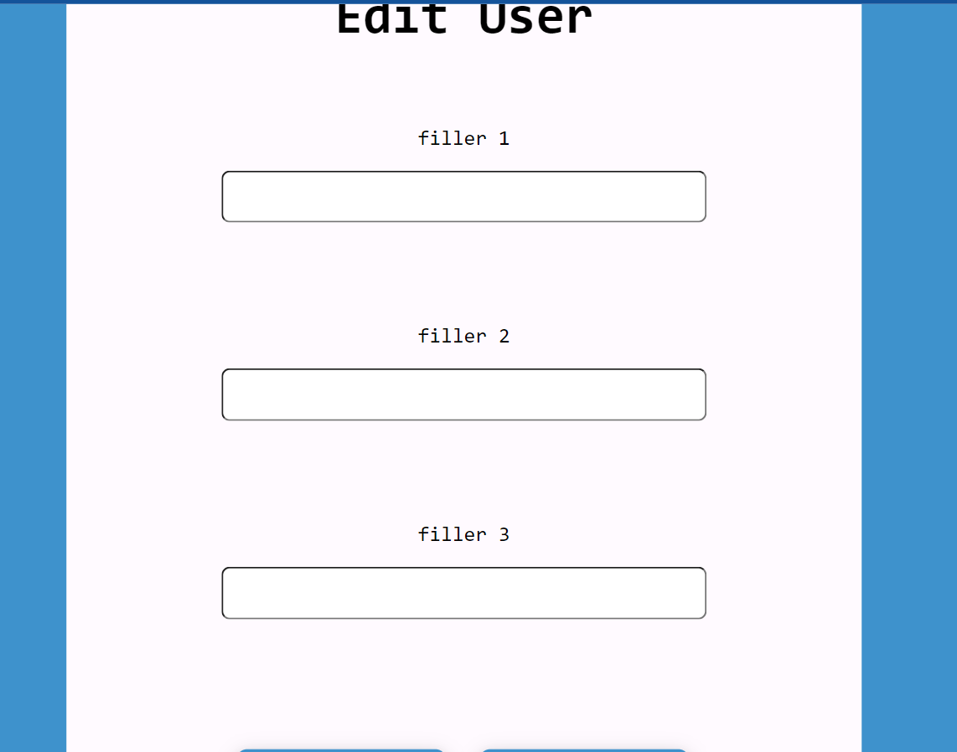
Front End- Admin Edit User page

Slide 15


Slide 17
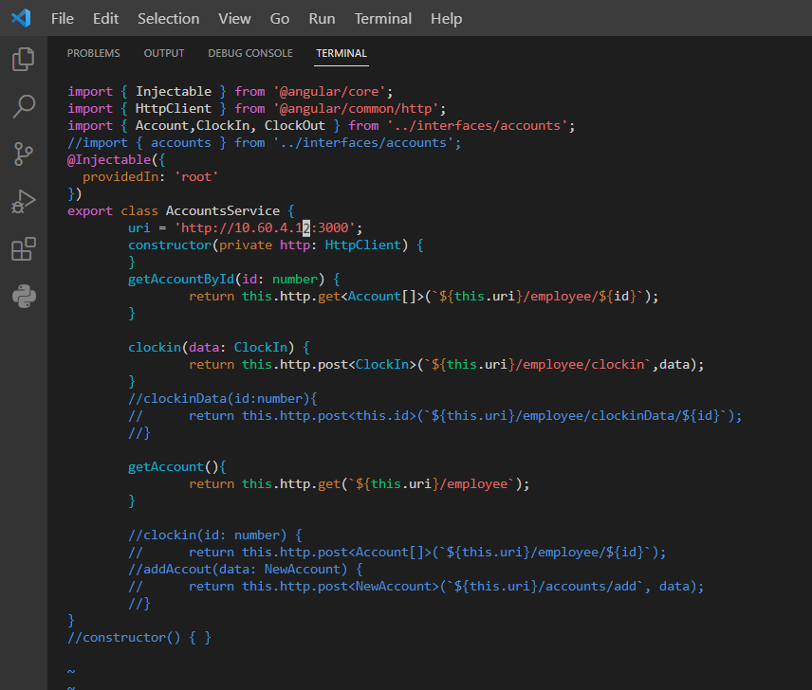
account.service.ts

Slide 18
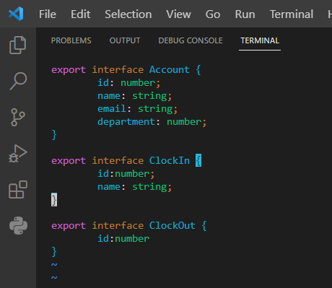
interface.ts

Slide 19
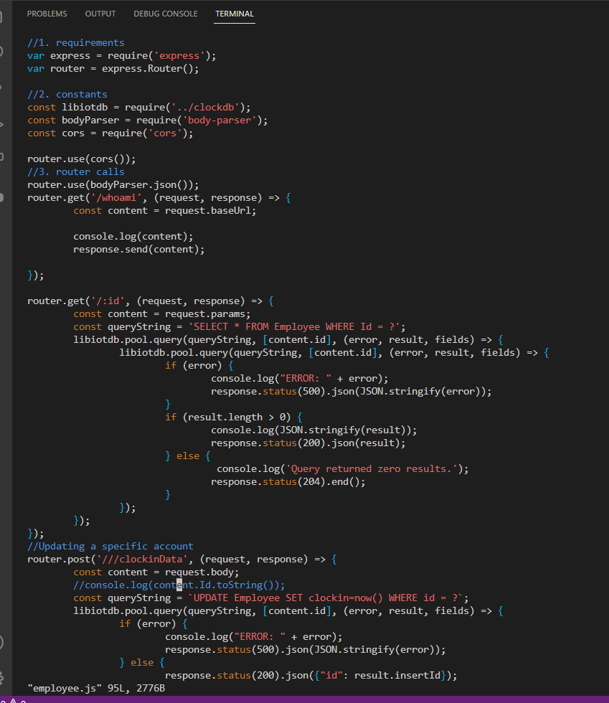
employee.js

Slide 20
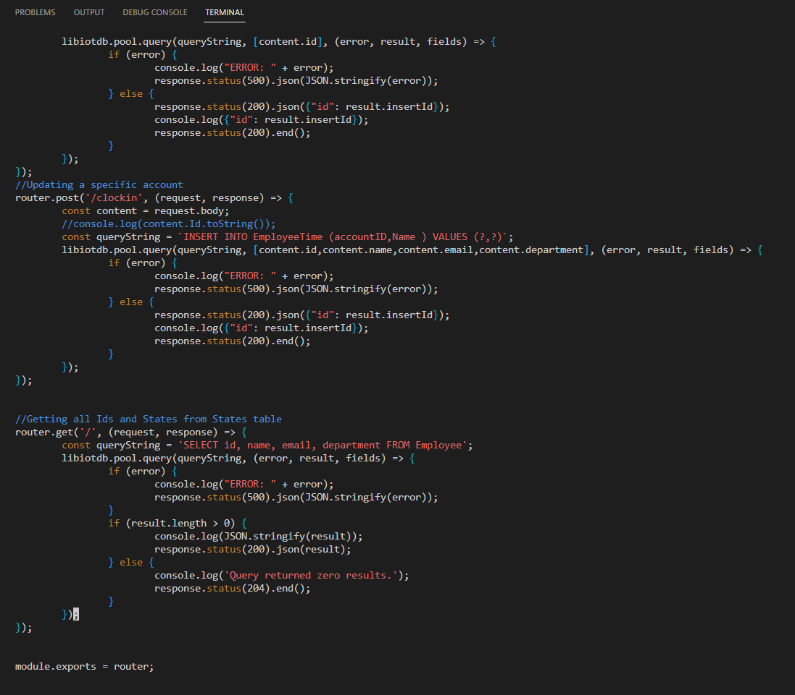
employee.js

Slide 21
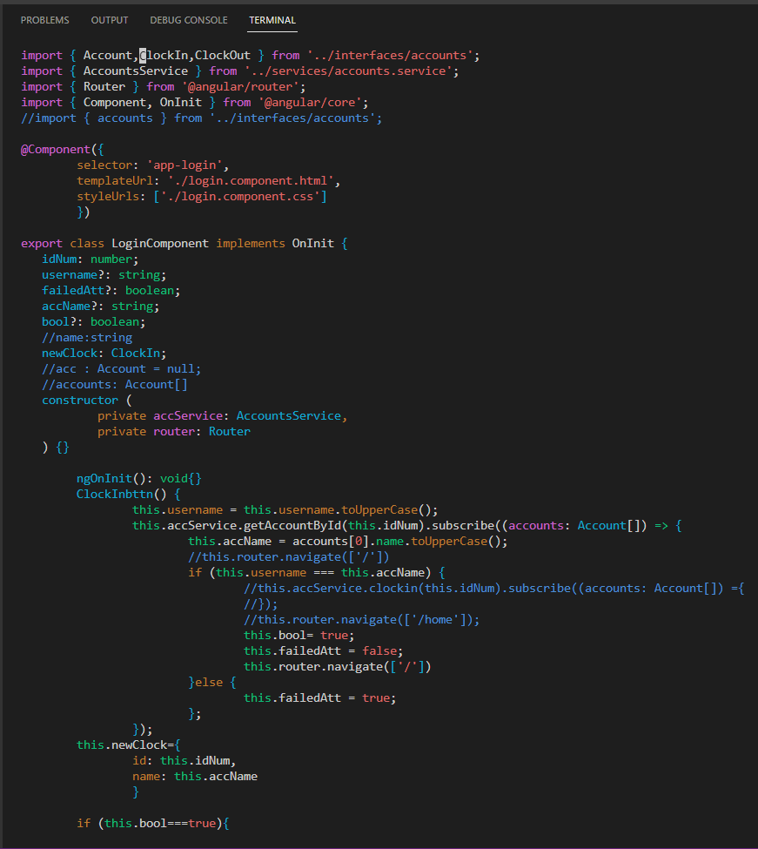
login.ts

Slide 22
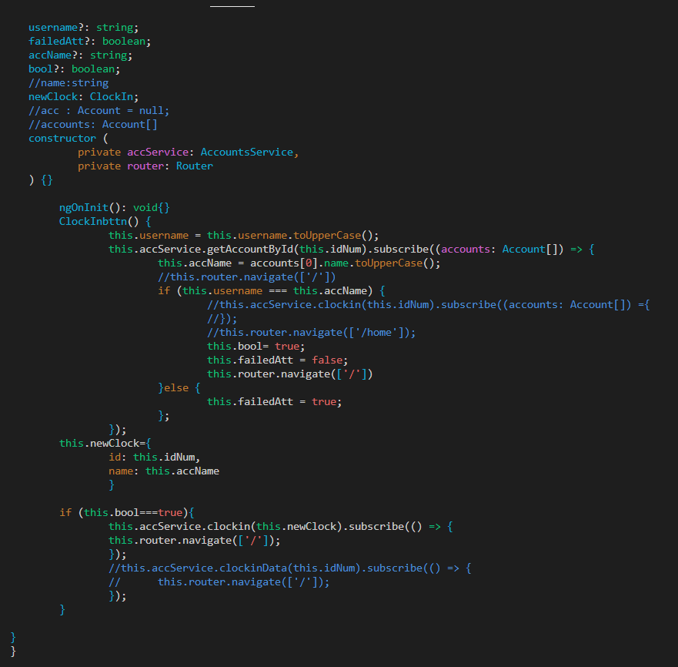
login.ts

Slide 23
Documentation
Link to documentation - Here

